Slide 1

Road Map Exercise:
Revisiting the Adaptive Problem Space
PCWG
15th Meeting: 9th December 2015 – Kings Langley

Slide 2
Adapted from work on adaptive leadership by Heifitz and Linsky
Far From Consensus
Complexity
Political
Adaptive Problems
Political Dimension
Simple
Close to Consensus
Technical Puzzles
Complicated
Close to Certainty
Far From Certainty
Technical Dimension

Slide 3
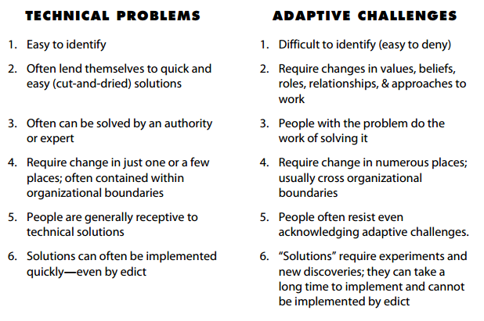
Source: http://www.groupsmith.com/uploads/file/technical%20problems%20vs%20%20adaptive%20challenges.pdf

Slide 4
Exercise: during the break mark the flipchart with an X to indicate where you think the wind industry is on the issue of turbine performance in outer range conditions.
Far From Consensus
X
X
Political Dimension
X
Close to Consensus
X
Close to Certainty
Far From Certainty
Technical Dimension

Slide 5
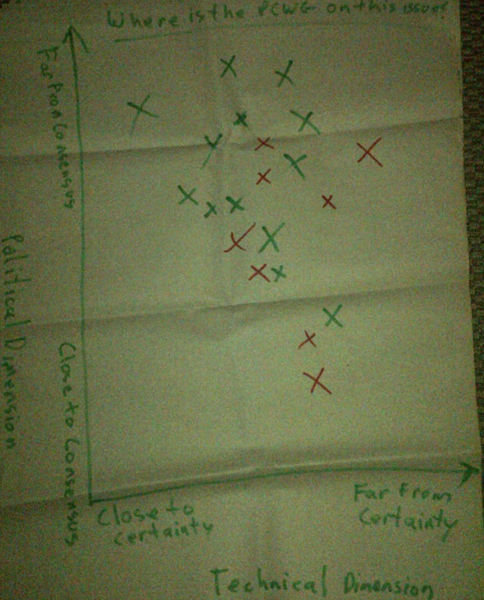
Results: Where is the PCWG on this Issue?
2014 Results
Far from Consensus
Political Dimension
Close to Consensus
Close to Certainty
Far From Certainty
Technical Dimension

Slide 6
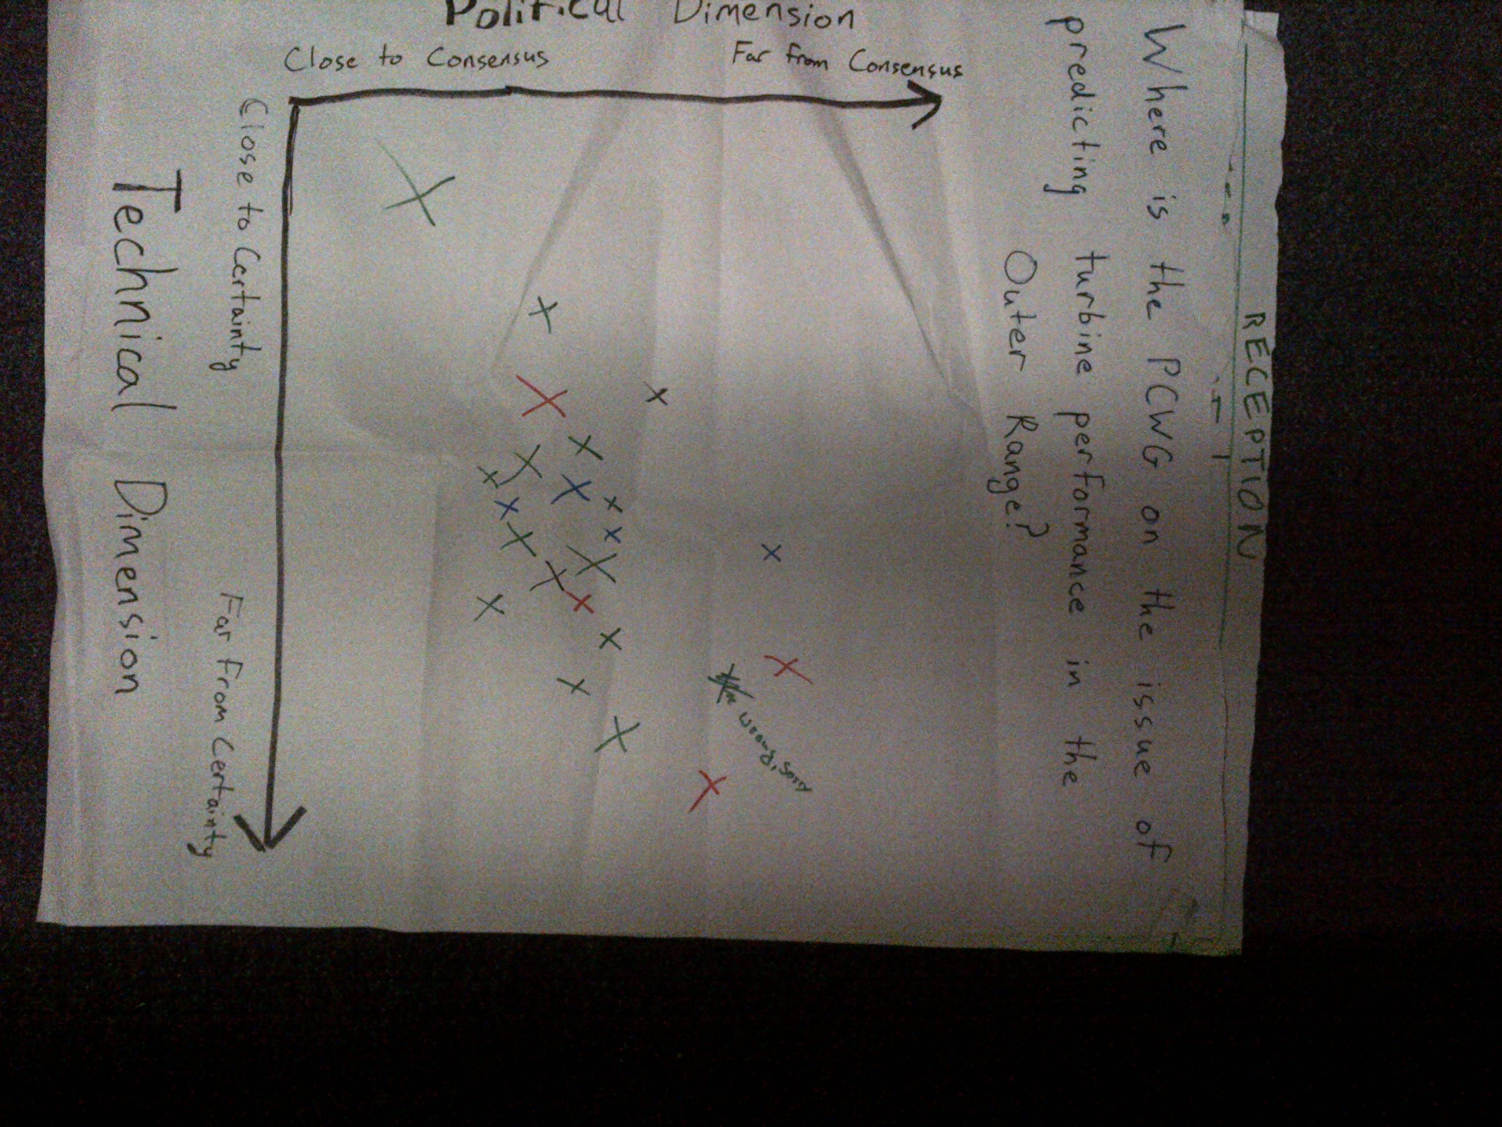
Results: Where is the PCWG on this Issue?
2015 Results
Far from Consensus
Political Dimension
Close to Consensus
Close to Certainty
Far From Certainty
Technical Dimension

Slide 7
Where is the PCWG on the issue of turbine performance in outer range conditions?
2014 Results
Far from Consensus
Political Dimension
Close to Consensus
Close to Certainty
Far From Certainty
Technical Dimension

Slide 8
Where is the PCWG on the issue of turbine performance in outer range conditions?
2015 Results
Far from Consensus
Political Dimension
Close to Consensus
Close to Certainty
Far From Certainty
Technical Dimension

